Slide 1
Covid-19 Dashboard
Done by: Abdul Haziq, Marni, Amal and Gary

Slide 2
Outline
Purpose of Dashboard
Introduction
Who done the tasks
Dataset Preparation
Marni Task
Haziq Task
Amal Task
Gary Task
Dashboard
Github link

Slide 3
Purpose of Dashboard
Users able to view:
Covid-19 Confirmed, deaths and recovered cases globally with provided graphical statistics.
Country-specific info by clicking on any country on the map.
Interactive chart showing reported cases by WHO
Help user to see correlations and relationships that can provide insights into COVID-19 and how communities responding to it

Slide 4
Introduction
The dashboard is supported by the team of four that gather data, make visualization and perform analysis regarding the COVID-19 epidemic.
The Dashboard is program by using JavaScript, HTML, CSS and D3.js
The Dashboard focus on the month of March
The Dashboard is compile from individual tasks

Slide 5
Software & Language Used
Notepad++
XAMPP
GitHub
D3 – JavaScript library
Visualization data – HTML, SVG & CSS
Visual Studio Code

Slide 6
Task distribution
1. Haziq – created the interactive map to show individual country with information of confirm cases, death and recovery statistics
2. Amal – created the total line graph of total confirmed cases, total deaths and total recovery
3. Marni – created COVID-19 Radial Scale Chart and Summary Tiles
4. Gary – created table of top 15 countries with confirm cases

Slide 7
Dataset Preparation
The data was obtained from Kaggle of up-to-date of COVID-19.
The first dataset contain the information from January until April.
The dataset obtained was extracted into three datasets namely Covid-19 dataset (March), covid-19top15 and covid-19 total datasets.
The Covid-19 March dataset narrow the information of single month.
The Covid-19top15 dataset contains the top 15 countries with most confirm cases of Covid-19.
Lastly, Covid-19 total contains the information per weekly
World-110m.json was added as well for d3 map

Slide 8
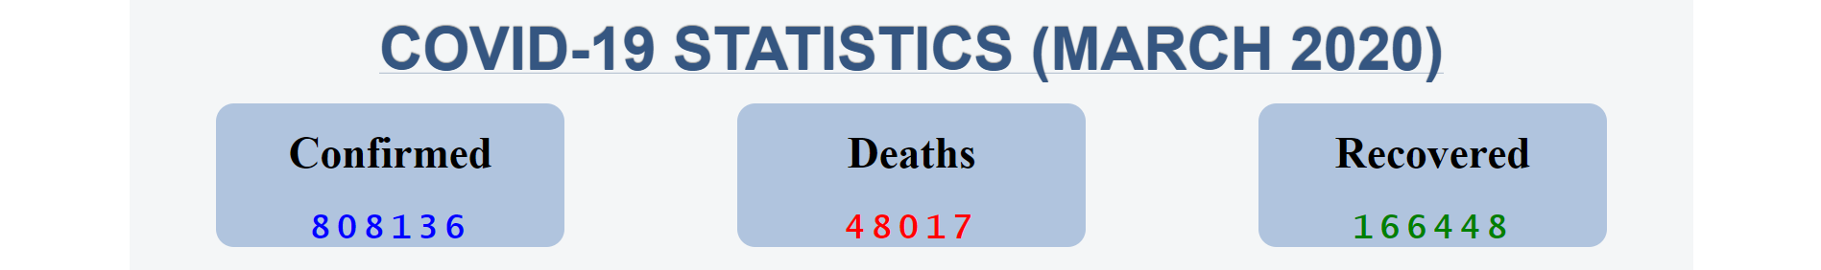
Marni Tasks
to compile all the total statistics of confirmed, death and recovered cases in Summary Tiles form.
A summary tile can be a powerful way to put attention to one, or several important statistics such as number of Confirmed case.
This can help to set tone for the rest of the Dashboard.
Different colors were used to show the significance for each summary tiles

Slide 9
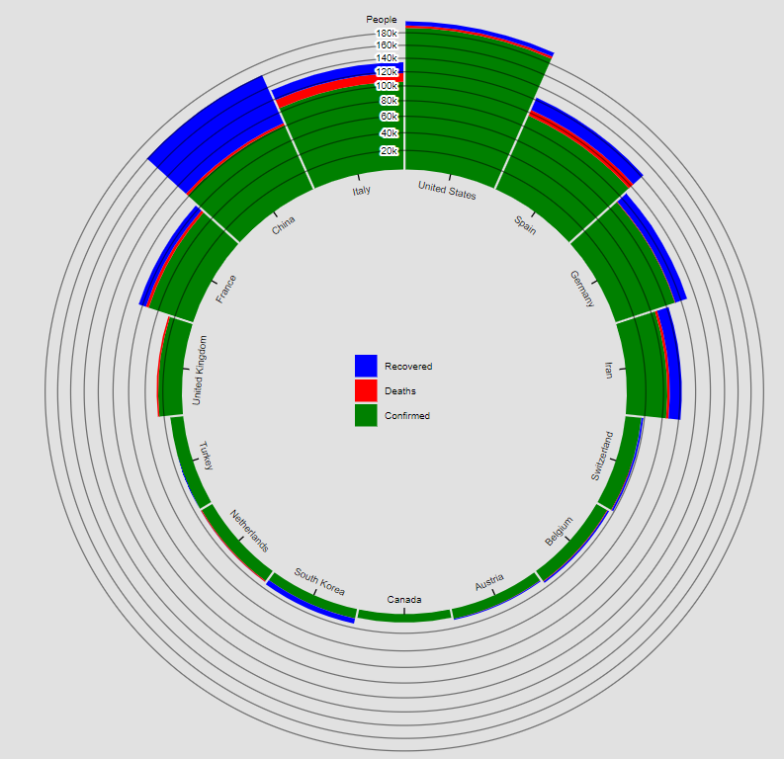
Marni Tasks
Radial Stacked Bar Chart to visualize Top 15 Countries w/ Confirmed Cases.
To compare countries total cases, different colors were used similarly w/ the Summary Tiles to show the significance of each total number of cases
Radial shape is to visualize the world

Slide 10
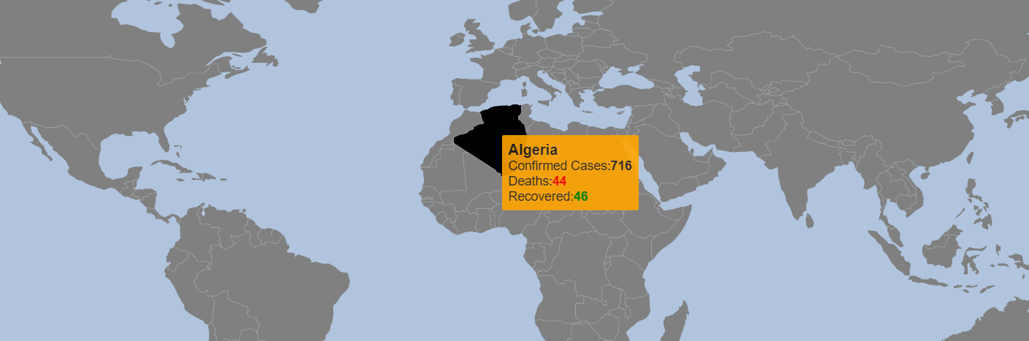
Haziq Task
Haziq’s task was to created interactive map that shows individual country with information by hovering around using tooltip.
Each country contains the name, number of confirmed cases, deaths and recovered.
Zooming capabilities with d3 zoom function.
Utilizing topojson dataset by linking country id with covid-19 dataset to fetch necessary data and features.

Slide 11
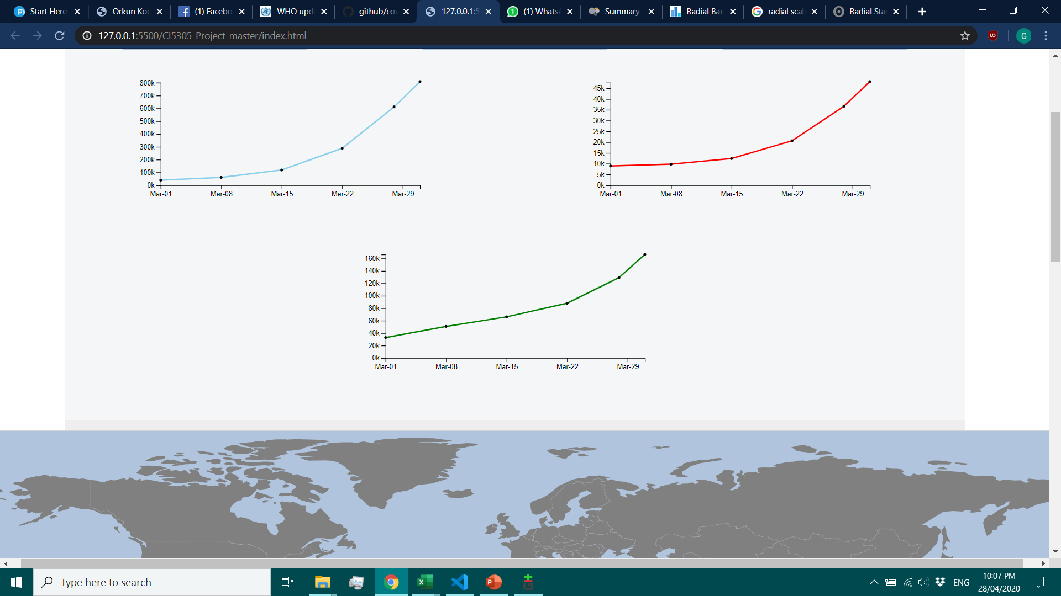
Amal Task
Confirmed Cases
Death Cases
Recovered Cases
Amal’s task was to create three line charts with 3 different cases
Confirmed cases (Blue), Death cases (Red), Recovered cases(Green).
The line chart displays the total number of cases by weekly for the month of march 2020. It shows the total value for all countries for each cases.
By using the tooltips, the information such as date and total number of the cases per week will be shown when pointing to the dot.

Slide 12
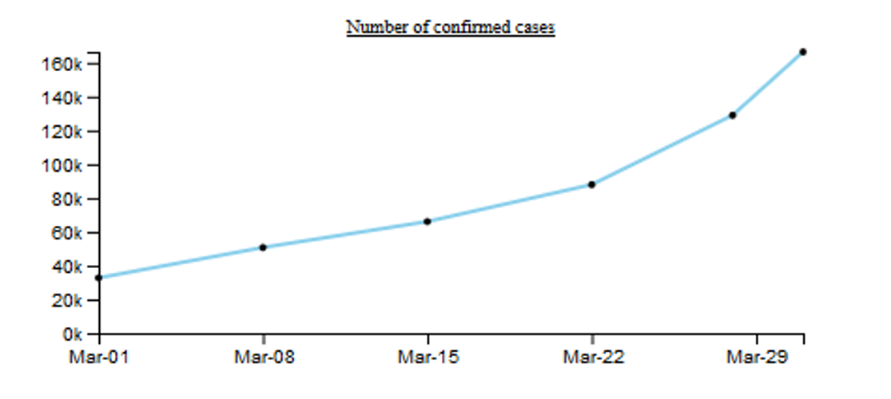

Slide 13
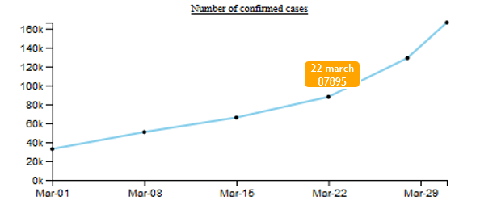

Slide 14
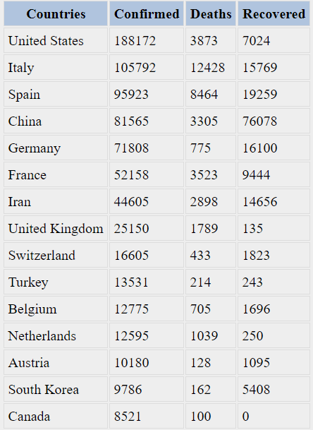
Gary Task
Gary’s task was to created Table chart of top 15 countries of highest confirmed cases in the month of March.
Implementation using D3 and used Covid-top15 dataset to list top 15 countries.

Slide 15
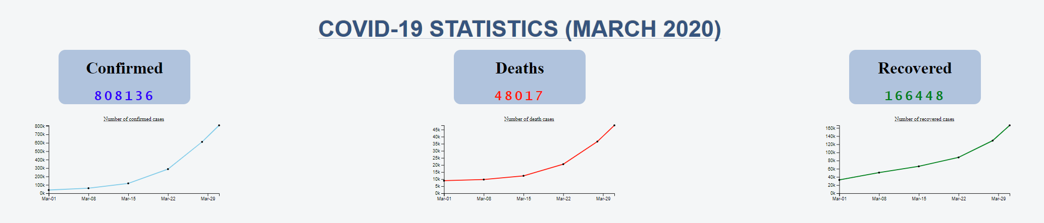
Dashboard

Slide 16
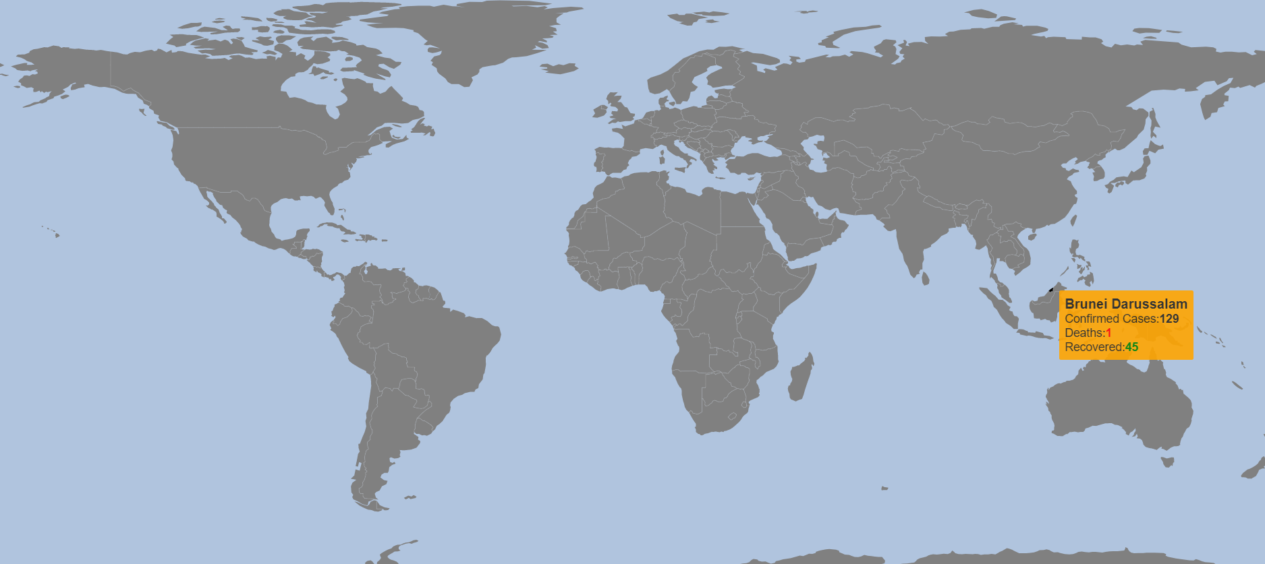
Dashboard

Slide 17
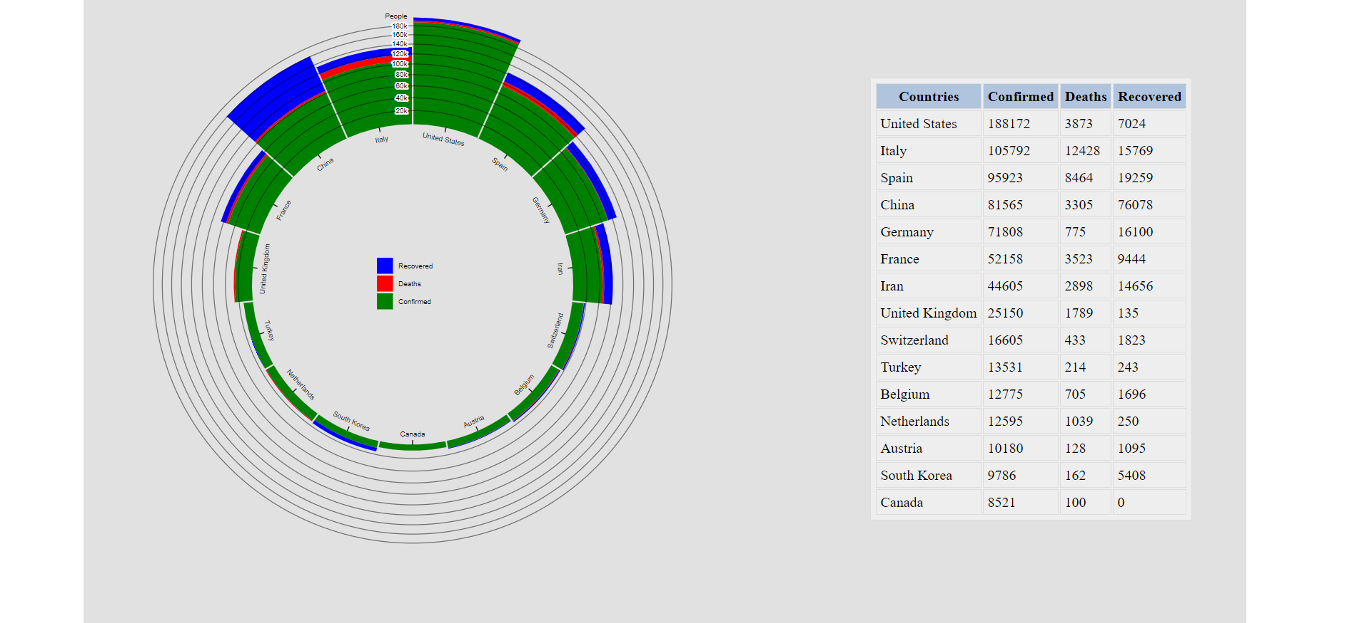
Dashboard

Slide 18
GitHub Link
Link: https://github.com/haziqqbaharin/CI5305-Project

